Slide 1
Proxy pricing: An example
Courtesy of Qiuzi Chen(‘18)

Slide 2
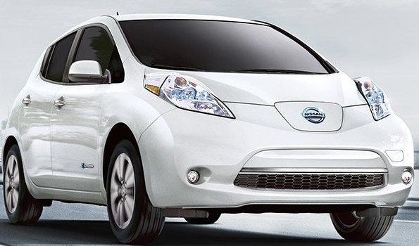



2017 Nissan Leaf Hatchback
2017 Ford Focus Electric
2017 Nissan Juke Hatchback
2017 Honda HR-V
Notes:
Similar interior volume

Slide 3
Electric Vehicles vs. Gas-Powered Vehicles
Cost in Net Present Value (in US dollar) | Ford Focus Electric 2017 | Nissan Leaf Hatchback 2017 | Nissan Juke Hatchback 2017 | Honda HR-V 2017
Upfront Cost | 29,100 | 30,700 | 20,300 | 19,500
Maintenance Cost | 9,900 | 9,300 | 12,200 | 14,000
Fuel Cost | 2,700 | 2,600 | 5,500 | 5,100
Insurance Cost | 11,800 | 11,200 | 10,300 | 9,800
Total Cost to Purchase | 53,500 | 53,800 | 48,200 | 48,400
Assumptions:
2.5% discount rate
Average miles per year: 6,738 miles;
Gasoline price $2.3/gal rising to $3/gal following EIA AEO 2017 projections
Notes:
Table: Comparison of total cost to purchase electric vehicles (Ford Focus Electric 2017 and Nissan Leaf Hatchback 2017) and gas-powered vehicles (Nissan Juke Hatchback 2017 and Honda HR-V 2017). Note: 1) Discount rate of 2.5% is used for NPV calculation; 2) average mile per year for a Smith fleet vehicle is assumed 6,738 miles; 3) fuel efficiency for Ford Focus, Nissan Leaf, Nissan Juke, and Honda HR-V are 31kwh/100mi, 30kwh/100mi, 3.4 gallon/mi, and 3.2 gallon/mi, respectively; 4) gas price is expected to be $2.3/gal for year 1 and increases gradually over the next 10 years and end-use electricity price is expected to fluctuate between 14.0 – 15.0 cent/kwh; 5) CO₂ emissions per mile is 110 g/mi for electric vehicles and 317 g/mi for gas-powered vehicles.

Slide 4
Electric Vehicles vs. Gas-Powered Vehicles
Cost in Net Present Value (in US dollar) | Ford Focus Electric 2017 | Nissan Leaf Hatchback 2017 | Nissan Juke Hatchback 2017 | Honda HR-V 2017
Upfront Cost | 29,100 | 30,700 | 20,300 | 19,500
Maintenance Cost | 9,900 | 9,300 | 12,200 | 14,000
Fuel Cost | 2,700 | 2,600 | 5,500 | 5,100
Insurance Cost | 11,800 | 11,200 | 10,300 | 9,800
Carbon Emissions Cost | 560 | 560 | 1,600 | 1,600
Total Cost to Purchase | 54,100 | 54,400 | 49,800 | 50,000
Assumptions:
Average miles per year: 6,738 miles;
Gasoline price $2.3/gal following EIA projections
CO₂ emissions per mile is 110 g/mi for electric vehicles and 317 g/mi for gas-powered vehicles;
Social cost of carbon is $70/ton, rising according to most recent (for now) USG estimates.
Notes:
Table: Comparison of total cost to purchase electric vehicles (Ford Focus Electric 2017 and Nissan Leaf Hatchback 2017) and gas-powered vehicles (Nissan Juke Hatchback 2017 and Honda HR-V 2017). Note: 1) Discount rate of 2.5% is used for NPV calculation; 2) average mile per year for a Smith fleet vehicle is assumed 6,738 miles; 3) fuel efficiency for Ford Focus, Nissan Leaf, Nissan Juke, and Honda HR-V are 31kwh/100mi, 30kwh/100mi, 3.4 gallon/mi, and 3.2 gallon/mi, respectively; 4) gas price is expected to be $2.3/gal for year 1 and increases gradually over the next 10 years and end-use electricity price is expected to fluctuate between 14.0 – 15.0 cent/kwh; 5) CO₂ emissions per mile is 110 g/mi for electric vehicles and 317 g/mi for gas-powered vehicles; 6) Social cost of carbon is $70 for year 1 and increments roughly by $1 yearly.

Slide 5
Electric Vehicles vs. Gas-Powered Vehicles
Cost in Net Present Value (in US dollar) | Ford Focus Electric 2017 | Nissan Leaf Hatchback 2017 | Nissan Juke Hatchback 2017 | Honda HR-V 2017
Upfront Cost | 29,100 | 30,700 | 20,300 | 19,500
Maintenance Cost | 9,900 | 9,300 | 12,200 | 14,000
Fuel Cost | 4,000 | 3,900 | 14,200 | 13,400
Insurance Cost | 11,800 | 11,200 | 10,300 | 9,800
Carbon Emissions Cost | 0 | 0 | 2,400 | 2,400
Total Cost to Purchase | 54,900 | 55,100 | 59,400 | 59,000
Assumptions:
Average mile per year 10,112 miles;
Gasoline price $3.50/gal following EIA high oil price projections (rising to $5.10/gal)
CO₂ emissions per mile is 0 g/mi for electric vehicles (RECs) and 317 g/mi for gas-powered vehicles;
Social cost of carbon is $70, rising according to most recent (for now) USG estimates.
Notes:
Table: Comparison of total cost to purchase electric vehicles (Ford Focus Electric 2017 and Nissan Leaf Hatchback 2017) and gas-powered vehicles (Nissan Juke Hatchback 2017 and Honda HR-V 2017). Note: all assumptions are identical to the previous scenario except for: 1) under the EIA high oil price trajectory, gas price is expected to increase from $3.5/gal to $5.1/gal over the next 10 years, and end-use electricity price, starting with 14.4 cent/kwh in year 1, is expected to fall and then rise up to 16.1 cent/kwh; 2) assuming Smith College will purchase renewable electricity, carbon emissions and hence carbon emissions cost for electric vehicles is assumed zero.

